Slide 1








become a data wizard
Data Cleaning with OpenRefine

Slide 2
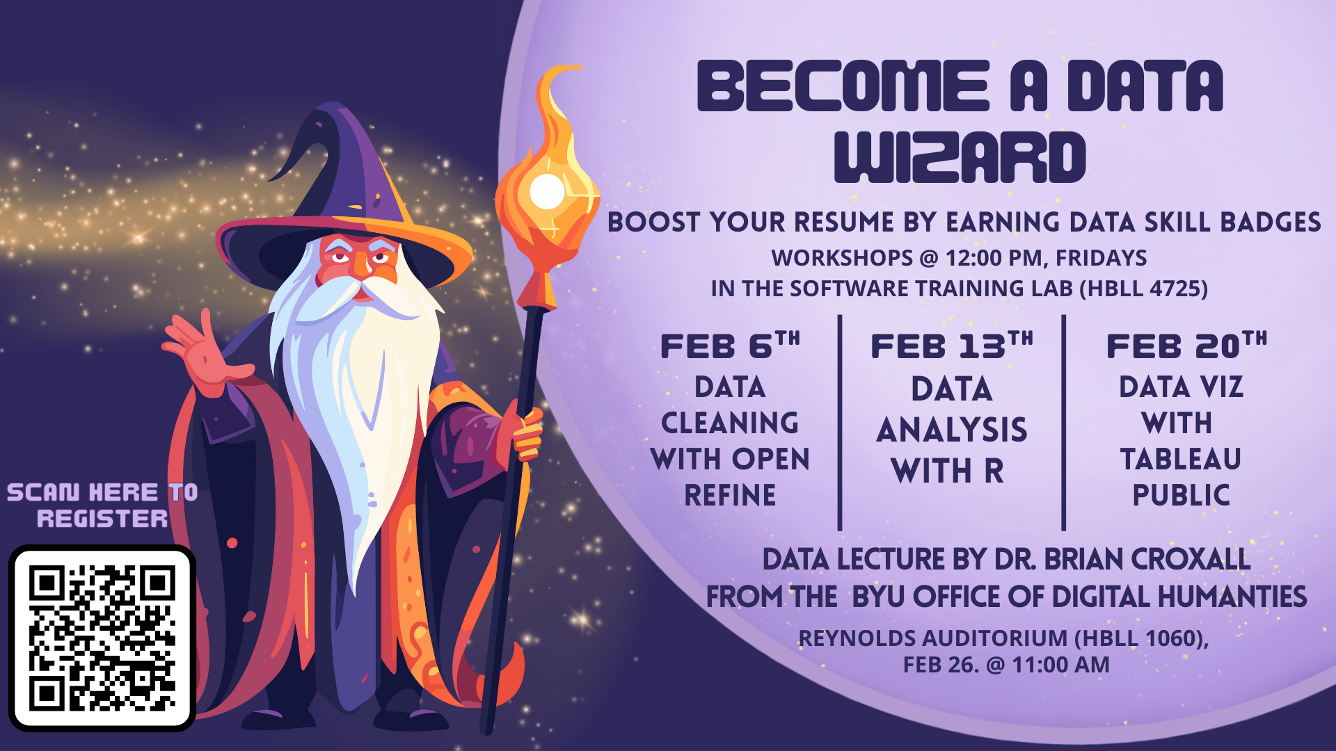

Slide 3


What is Openrefine?
A powerful, free tool for cleaning messy data
User-Friendly: a point-and-click interface
Efficient: cleans thousands of rows at once
Safe: original data file stays untouched while you work

Slide 4

Goals
Navigate the OpenRefine Interface
Audit Data through Faceting
Standardize Data
Clean Cells with Transformations
Document and Export Results

Slide 5

Link for DataSet
https://tinyurl.com/yh78cdv7
(if you haven’t received an email with a link)

Slide 6
CHALLENGE
Time Traveler
Currency Confuser
Location Cleanup
Millionaire
See who can get “Country” down to the fewest number of choices!
Find the people whose “Years of Experience” is higher than their “Age.” What will you do with these entries?
Find entries with salaries so high that they must be errors. How will you deal with these?
Find entries with “Other” reported as their currency, but then write “USD” for that other currency.
Choose your Own Adventure
Find something else you want to work on cleaning! There are lots of options!

Slide 7

Cheat Sheet
GOAL | TOOL TO USE
Get a “Top 10” list of values | Text Facet
Find the highest/lowest numbers | Numeric Facet
Fix 50 typos at once | Clustering
Change “5000” to a real number | Common Transform → To Number
Messed up! | Undo / Redo Tab

Slide 8


Extra Resources
Ruben Verborgh & Max De Wilde: Using OpenRefine
Programming Historian (programminghistorian.org)
OpenRefine User Manual (docs.openrefine.org)
learning.oreilly.com/library/view/using-openrefine/9781783289080/ch03.html#ch03lvl1sec24

Slide 9
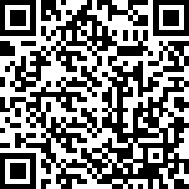

Thank you

